Slide 1
Balanced and Well-spread Subsampling for Better Phylogenetic Inferences in Epidemiology
2024/09/17
Guppy Stott
Institute of Bioinformatics, Center for the Ecology of Infectious Diseases, University of Georgia

Slide 2
What to Expect
Brief introduction and motivation
LCUBE subsampling
Methodology for comparison
Results
Conclusions and future work

Slide 3
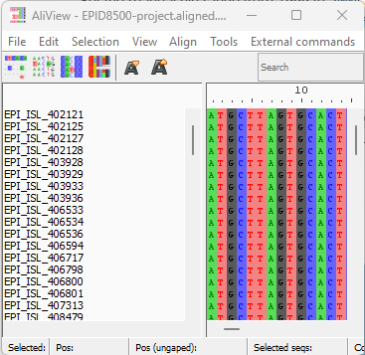
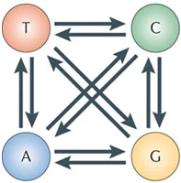
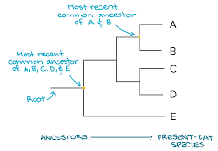
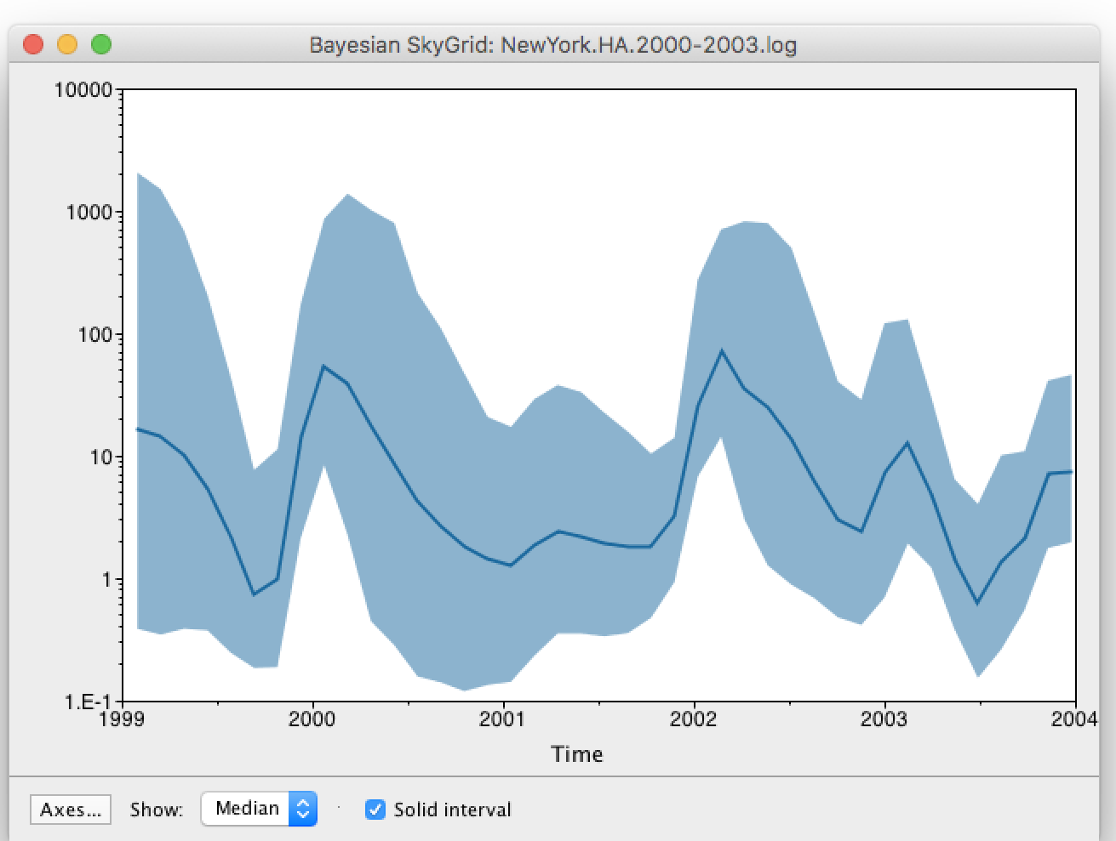
What is phylogenetic inference?
As viruses replicate, errors are made and recorded in their genomes
Sequence data provide a record of pathogens’ evolutionary history
By applying substitution models and phylogenetic inference, we can test hypotheses about their spread, epidemiologic parameter estimates, and origins
Part 1/5: Introduction
Notes:
Sequence data contain a record of mutations over time
Molecular epidemiology uses the information contained in sequence data to infer evolutionary histories and infer epidemiologically relevant parameters

Slide 4
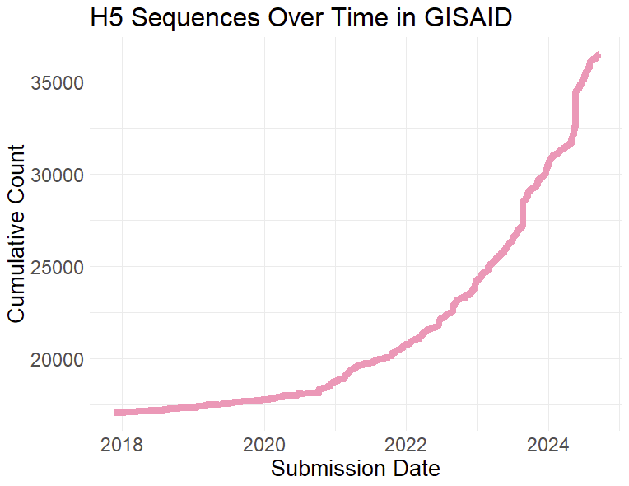
The rapid growth in sequence data has created challenges
More data proves challenging for computationally complex methods
The growth in available data is not uniform across regions, host, or other covariates
Part 1/5: Introduction

Slide 5
The approaches for addressing this challenge vary
Modifications to the Bayesian inference methods
Simpler models or heuristic estimates to make computation more tractable (e.g., approximate Bayesian computation)
More complex models which help reduce the impact of biased input data (e.g., structured coalescent)
Methods for updating existing phylogenetic analyses with new data (e.g.,“online” updates to phylodynamic models found in Beast 2)
Modified maximum likelihood methods to give users a balance between the features of each
Better subsampling choices to make our data more informative.
Part 1/5: Introduction

Slide 6
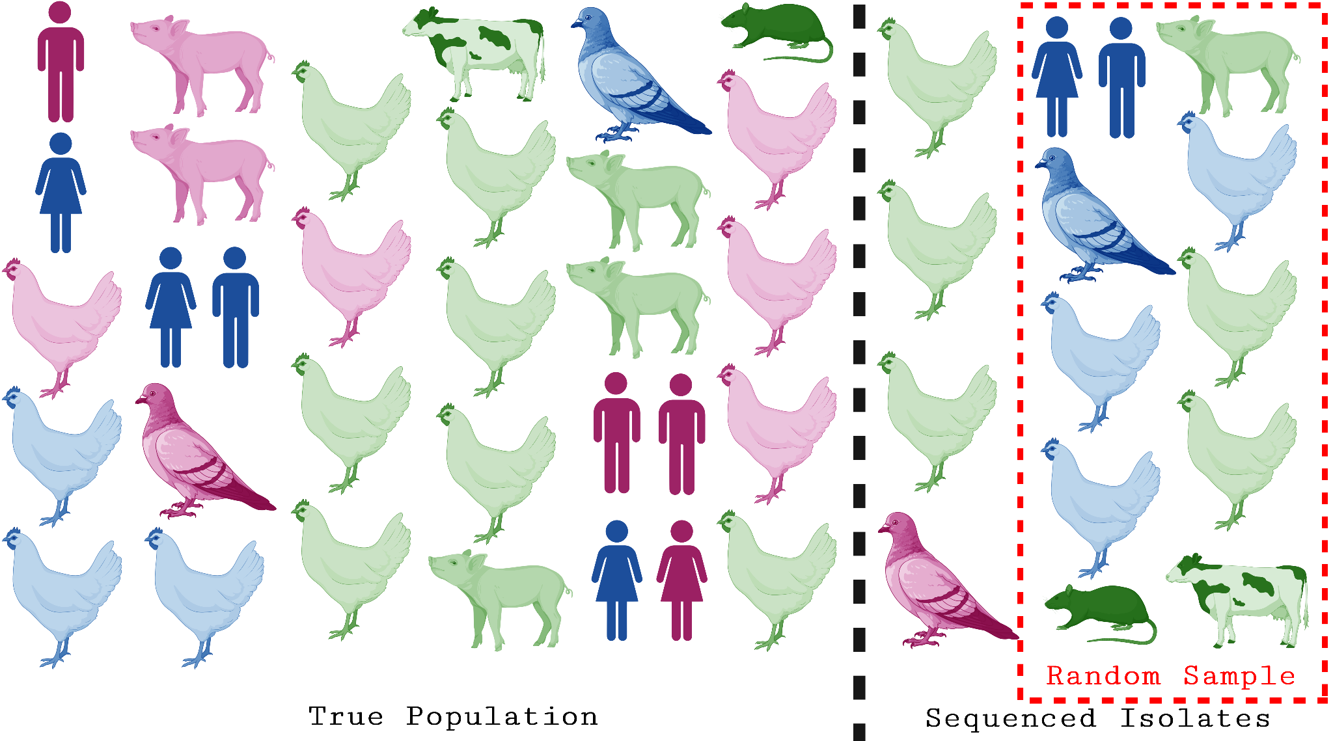
Why does subsampling for Bayesian phylogenetics pose a unique challenge?
Publicly available sequence data are convenience samples, not representative ones
Subsamples not taking into account population structure may lead to biased estimates
Part 1/5: Introduction
Notes:
Ducks chickens and people version plz

Slide 7
What about the existing landscape of subsampling tools?
 | TARDIS | PARNAS | PDA | CovSampler | Subsampler | PAST (our tool)
Genetic Diversity | + | + | + | + | - | +
Temporal Spread | + | - | - | + | - | +
Proportional to Outbreak Size | - | - | - | - | + | -
Weighting (e.g. predicted fitness) | - | + | - | - | - | +
Host Taxonomic Distance | - | - | - | - | - | +
Spatial Distance | - | - | - | + | - | +
Part 1/5: Introduction
Notes:
How do we subsample for Bayesian phylogenetic methods while preserving other key covariates like spatial distance or host diversity?
Are you saying our past is our future?

Slide 8
LCUBE Subsampling

Slide 9
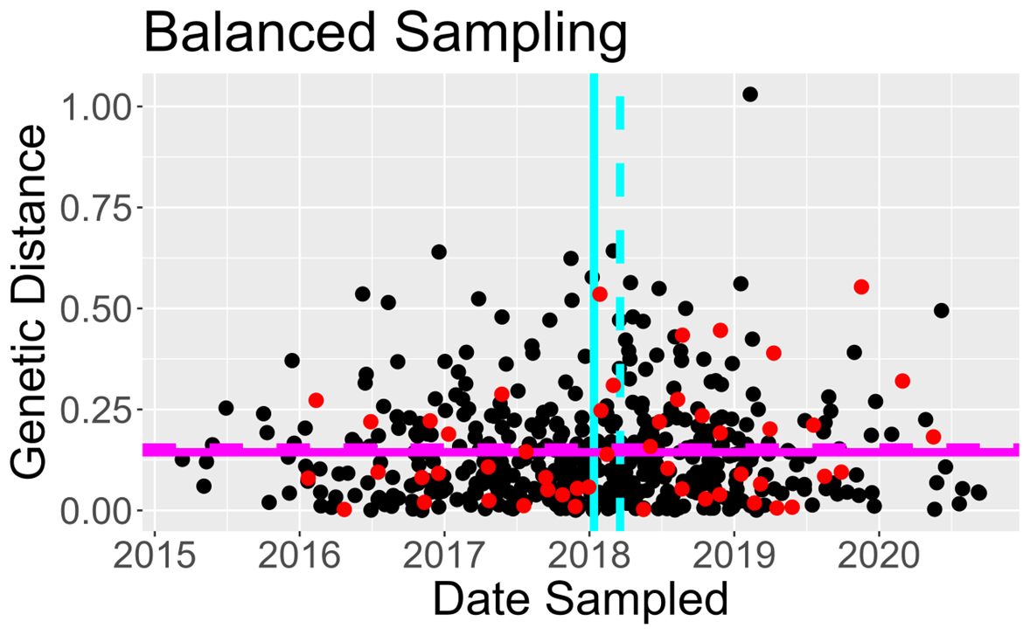
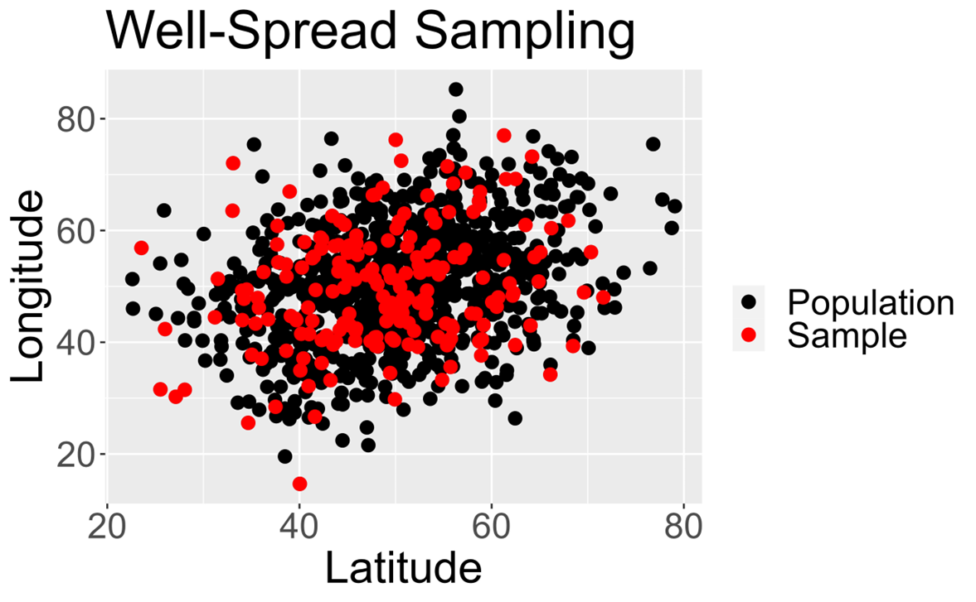
What makes a desirable subsample?
Well spread samples, like you would expect, are samples that include all the extreme values while not neglecting intermediate values
Balanced samples have the property that for each covariate, the mean generated from the sample is equal to (or close to equal to) the mean generated from the full population
Part 2/5: LCUBE
Notes:
Model-assisted subsampling strategy using the local cube method
Randomly selects a well-spread and balanced subsample across multiple variables
Allows for weighting of sequences to include things like case counts or known biases in sequence availability

Slide 10
How do we achieve a balanced and well-spread sample?
The LCUBE method, a “doubly balanced” sampling strategy for efficient analysis of ecological survey data
Initially developed by Grafström and Tillé in 2013
Combines ideas from local pivotal and cube sampling methods
Local pivotal: Leverages stepwise sample identification, each time you include an element in your sample, you reduce the probability of drawing its neighbors to guaranteed a spread sample
Cube sampling: Random sampling under a constraint which guarantees (almost) balanced sample
Let’s briefly walk through how this works…
Part 2/5: LCUBE

Slide 11
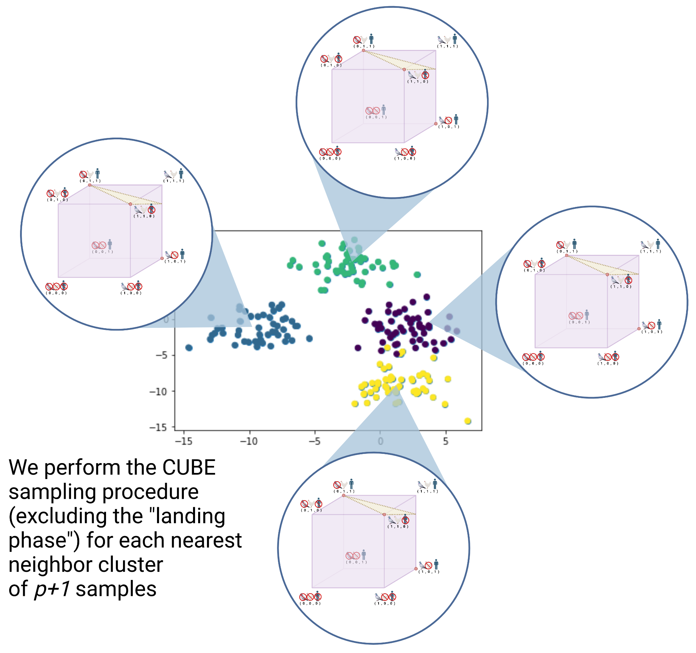
Phase 1: Clustering
Start by creating clusters of p+1 samples
Where p is the number of balancing variables
For each cluster, we will perform a CUBE subsampling step
Part 2/5: LCUBE

Slide 12
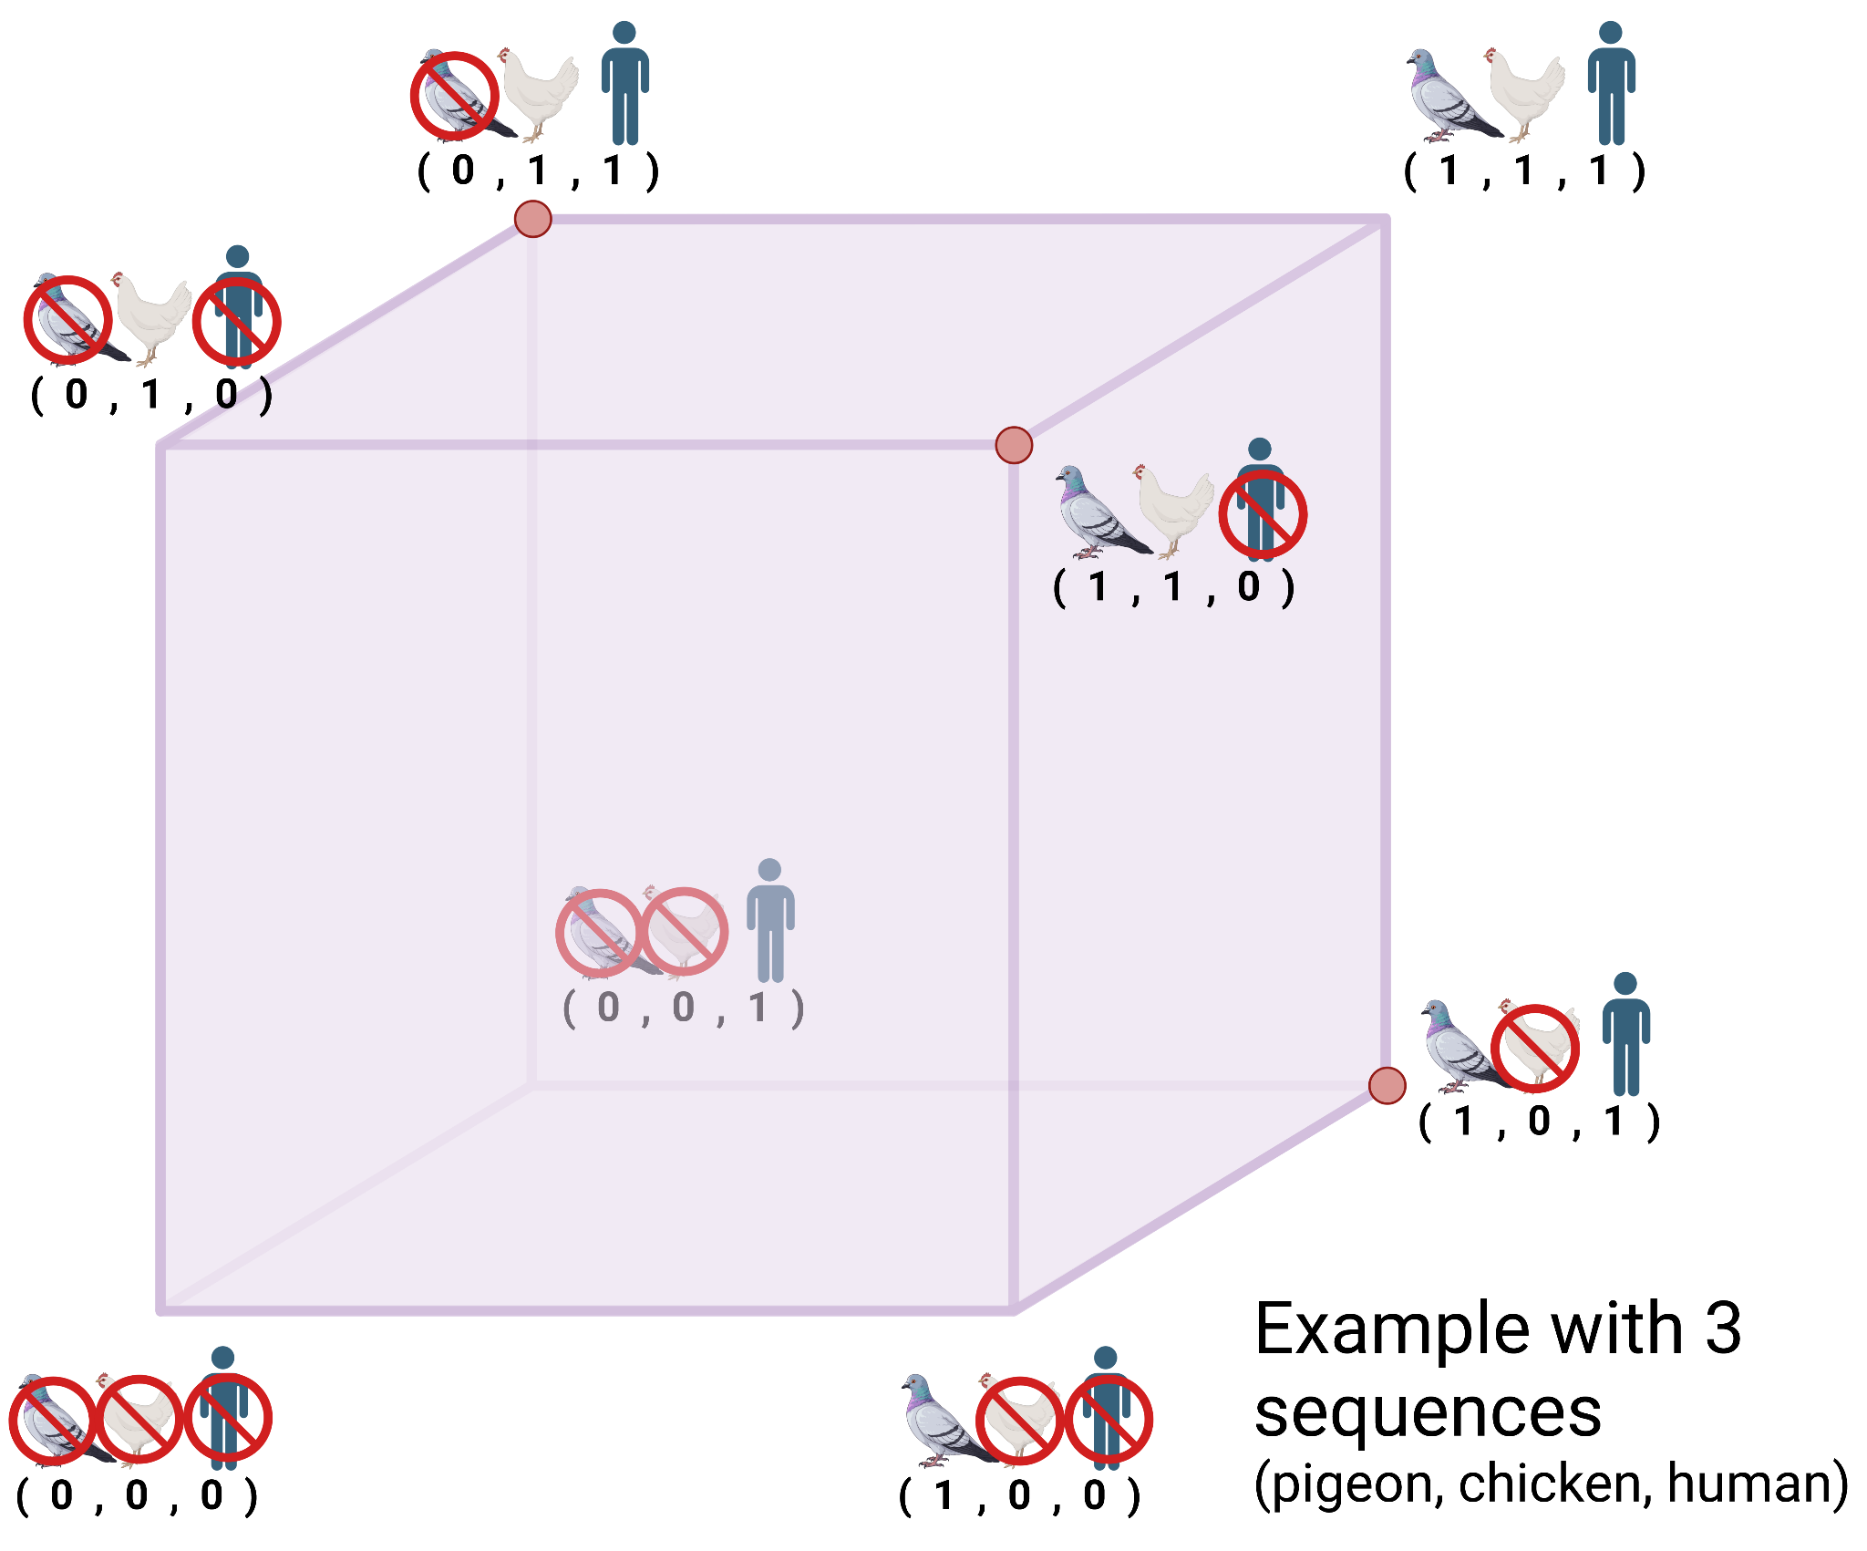
For each cluster, we use cube sampling
Samples in a population can be represented geometrically by an n-dimensional space where n is the total size of the population
In this example, we have a population size of 3 with different hosts: pigeon, chicken, and human.
If we want a sample of size 2, there are 3 valid points (red)
Part 2/5: LCUBE

Slide 13
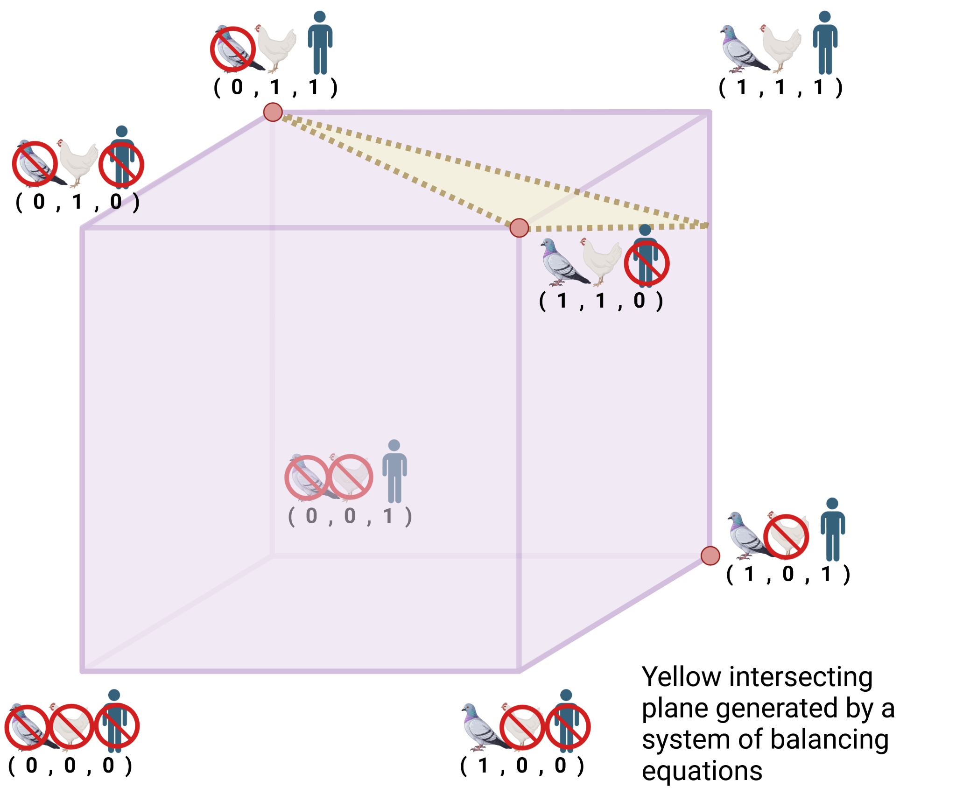
Balancing equations constrain the space
We leverage a system of balancing equations to generate an intersecting plane (yellow)
This plane may intersect a valid sample (e.g. 2 of the red dots) or not
Part 2/5: LCUBE

Slide 14
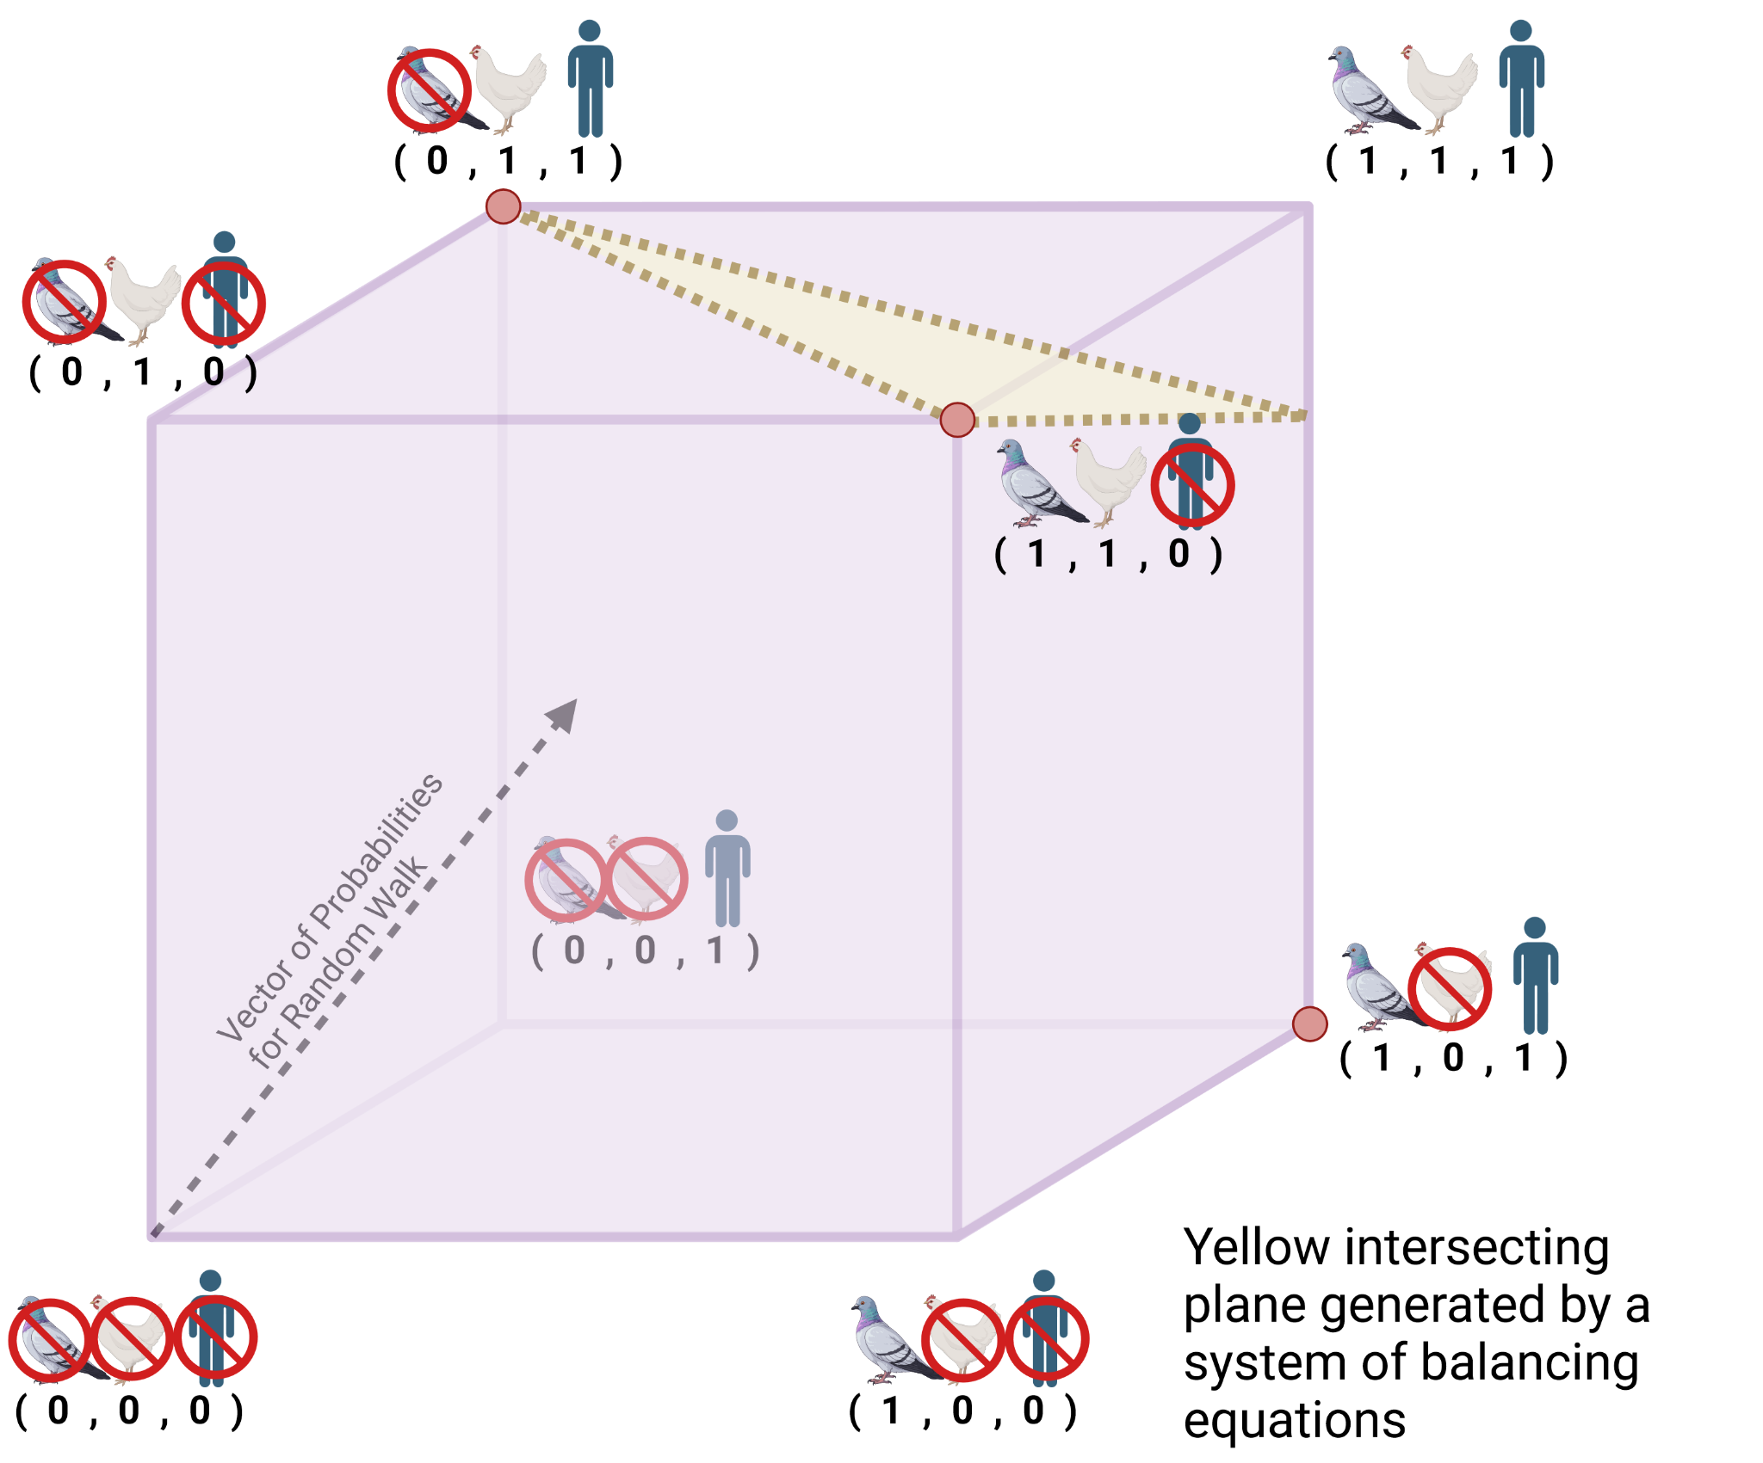
A random walk maintains “randomness”
We then use a probability vector directed towards the surface of balancing equations to begin a random walk
We wander until we reach an edge
At least one individual will be added to our sample at the end of the random walk
Part 2/5: LCUBE

Slide 15
Then, we repeat for the remaining data points
Create clusters of p+1 samples
Where p is the number of balancing variables
Perform a CUBE subsampling step
If there are less than p+1 samples left, perform the “landing phase”
Landing phase “rounds up” according to a linear program that optimizes cost of a sample
Or relaxes the constraint space for large p
Part 2/5: LCUBE

Slide 16
Methodology for comparison

Slide 17
Simulated outbreaks to investigate subsampling impacts
Discrete phylogeographic analysis on simulated data
Three different sequencing conditions:
Proportional sampling (every location has the same likelihood of sequencing an isolate)
High and low resource regions (one location has a lower likelihood of sequencing an isolate)
Delayed sampling in a region (one location is more likely to sequence earlier isolates and less likely to have sequences for later isolates)
DiversiTree simulates discrete trait evolution under the MuSSE model
Used LPhy BEAST generates Beast XML programmatically
Part 3/5: Methodology

Slide 18
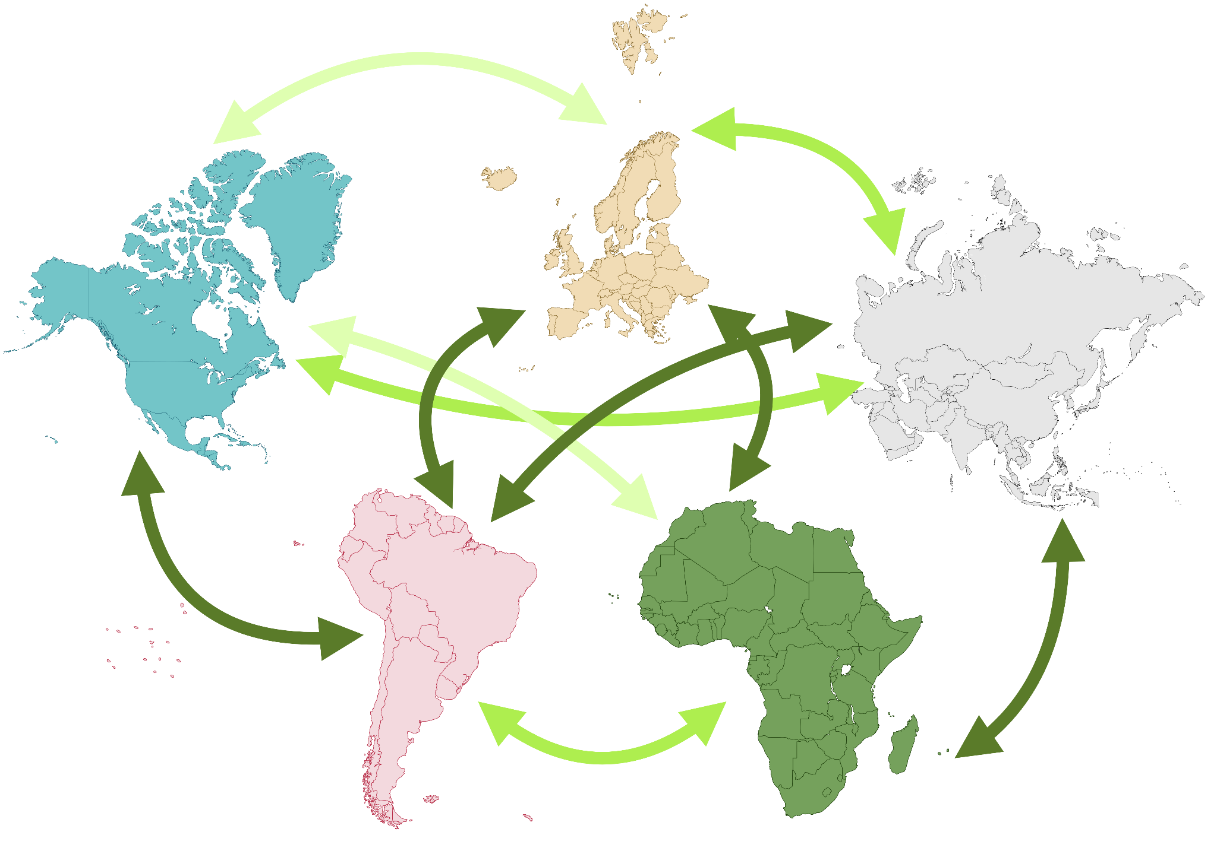
Discrete trait phylogeographic model for simulation
All outbreaks originate in Region 1
Diversitree for simulation of a true evolutionary history
Transition rate matrix among 5 populations
Low, medium, and high transition rates
3
4
1
2
5
Part 3/5: Methodology

Slide 19
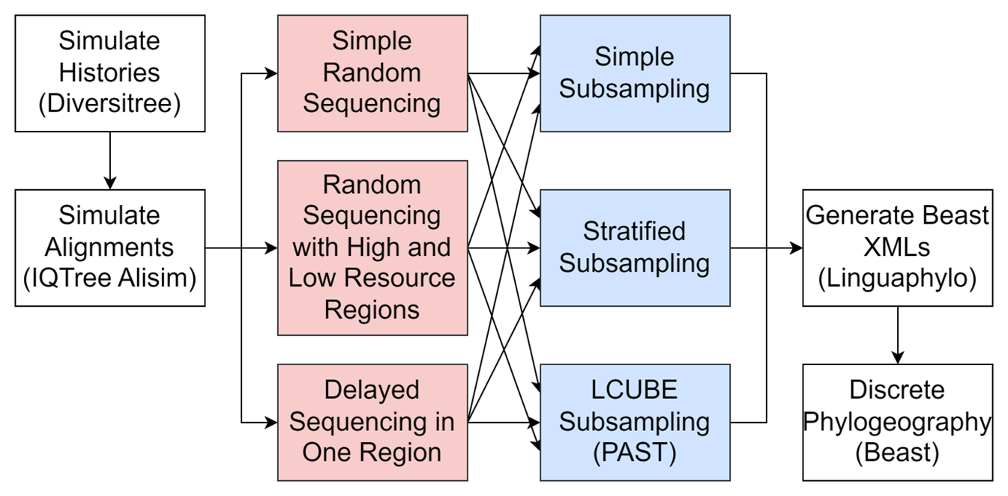
Our Nextflow workflow diagram
Part 3/5: Methodology

Slide 20
Results

Slide 21
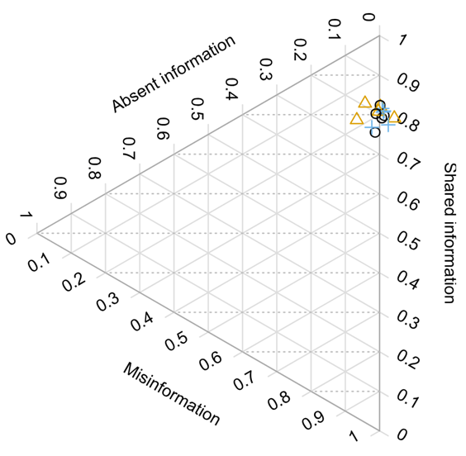
While topologically, trees were fairly similar…
Shared information: proportion of information shared with the true tree
Absent information: proportion of information missing from the tree
Misinformation: proportion of information that is false compared to true tree
All three subsampling strategies lead to trees with well-resolved topologies.
Part 4/5: Results

Slide 22
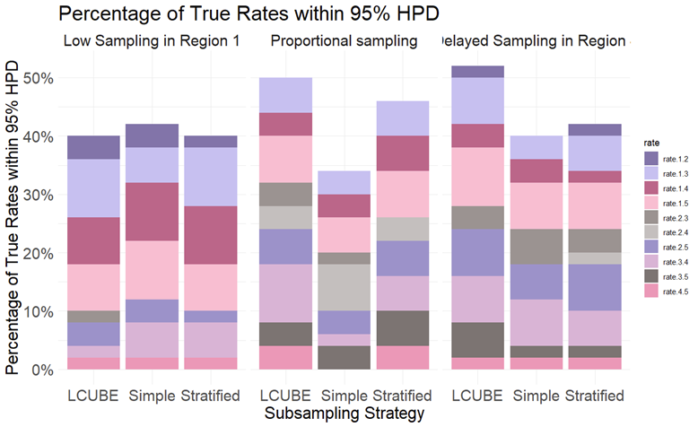
There were differences in our ability to infer transition rates
LCUBE performs at least as well as other methods
LCUBE outperforms other subsampling schemes under complex sequencing scenarios
D
3
Part 4/5: Results

Slide 23
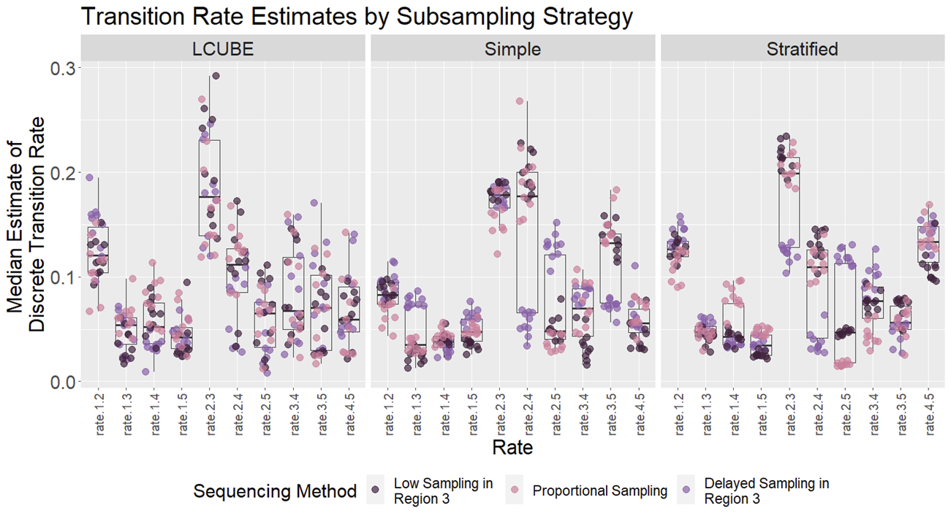
Changes to sequencing scenario can bias our estimates
Point estimates of transition rates may be biased
The uncertainty in our estimates is better captured by LCUBE
Part 4/5: Results

Slide 24
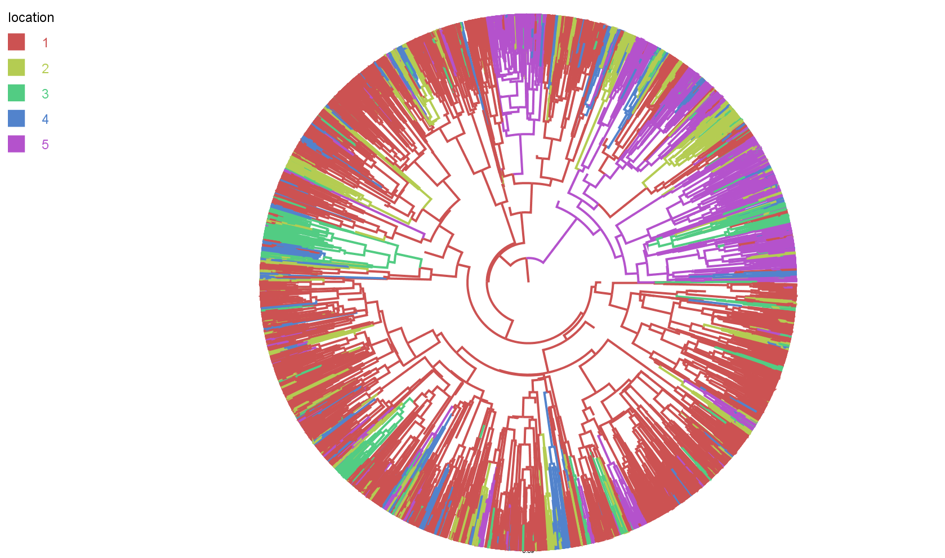
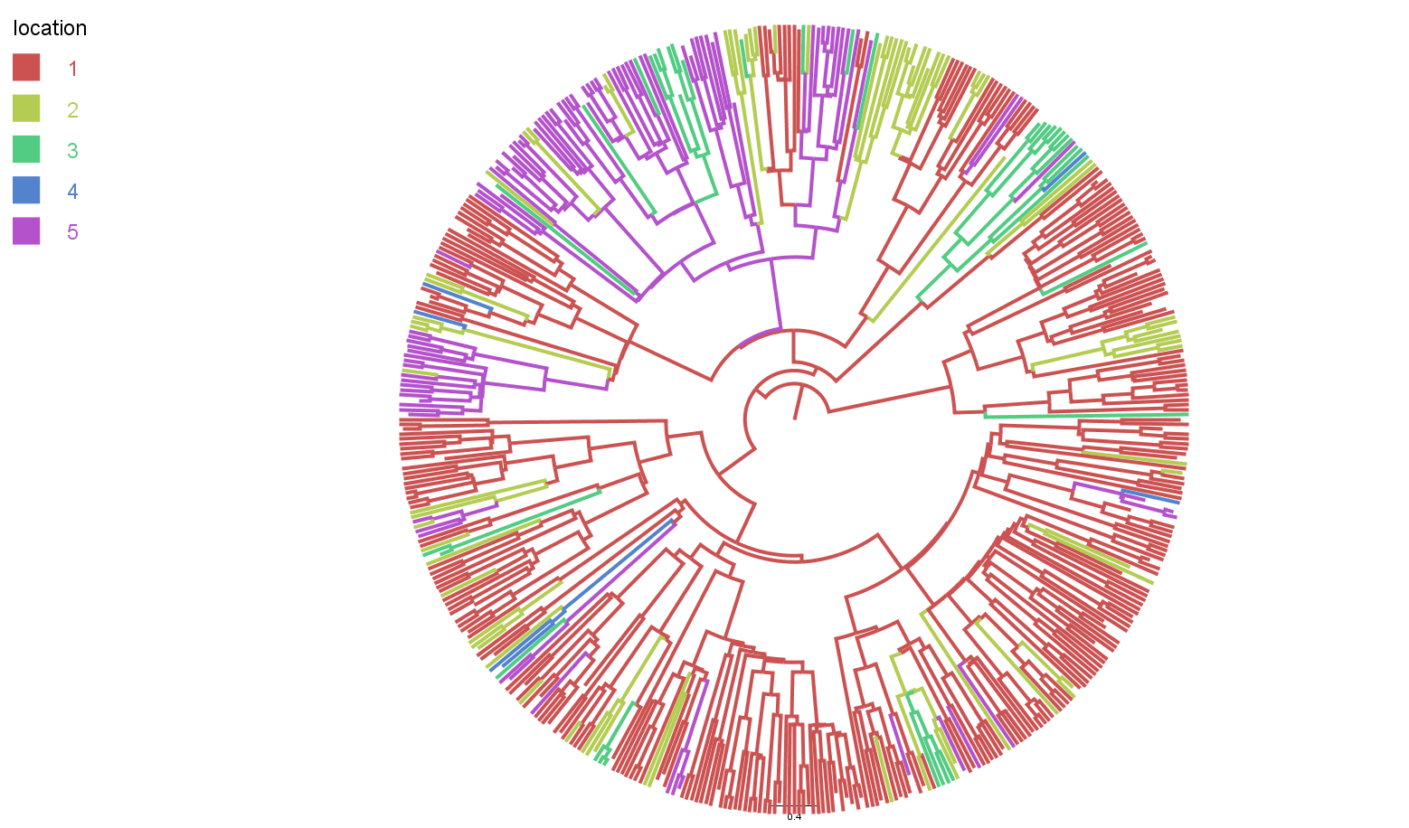
LCUBE subsampling preserves major features of the tree
Part 4/5: Results

Slide 25
Conclusions

Slide 26
Key takeaways
Transition rate estimates between locations are impacted by sequencing scenario
Simple random sampling and stratified random sampling can both lead to consistent, yet biased estimates of transition rates
LCUBE provides point estimates that capture more of the true variation in the available data
Part 5/5: Conclusions

Slide 27
Next Steps
Use GeoSSE model to simulate continuous phylogeography
Investigate proportion of tree which accurately infers location
Integrate features like predicted antigenic distance and host distance
Use additional data like outbreak size to weight sample inclusion
Build a user-friendly interface for subsampling to improve adoption
Part 5/5: Conclusions

Slide 28
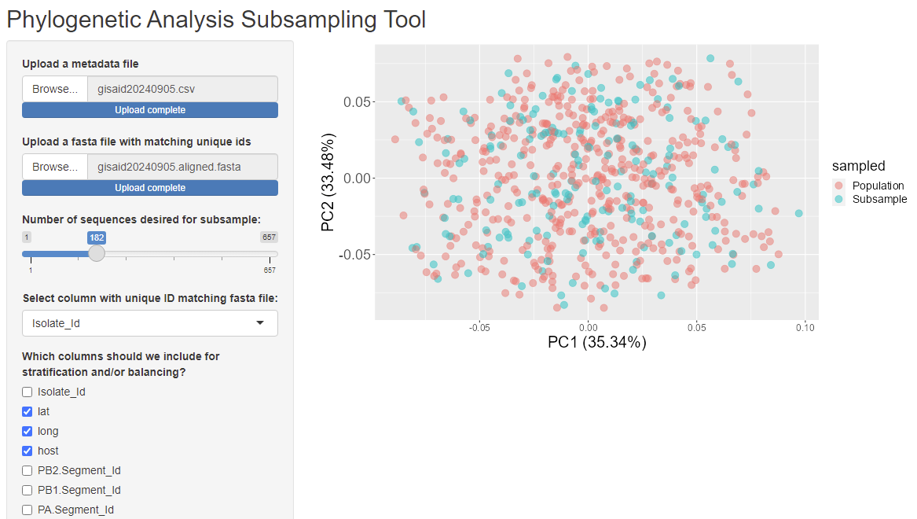
Future work: A GUI applet for LCUBE subsampling
Developing a user-friendly interface for subsampling
Allows user to easily swap between subsampling strategies
Part 5/5: Conclusions

Slide 29


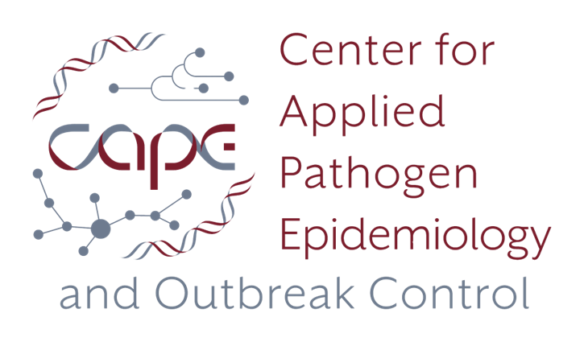
Acknowledgements
Bahl Lab (Applied Molecular Epidemiology Research Group)
Leke Lyu
Gabriella Veytsel
Cody Dailey
Justin Bahl
Stephani Mock
PIPP Phase I Research Group
Barbara Han
Hailey Robertson
Ellie Graeden
John Drake
Institute of Bioinformatics Staff
April King Mosley
Sandra Getz
Jara Usherwood
My dissertation committee
Amy Winter
Mandev Gill
Liang Liu

Slide 30
Summary
Phylogenetics can provide a lens into the lived history of a virus, but working with large datasets can prove computationally intractable
Transition rate estimates between locations are impacted by sequencing scenario
Simple random sampling and stratified random sampling can both lead to consistent, yet biased estimates of transition rates
LCUBE provides point estimates that capture more of the true variation in the available data
Future work will focus on creating a GUI for easier use of LCUBE and extending our test cases
Part 5/5: Conclusions
guppy.stott@uga.edu (Guppy Stott, they/them)

Slide 31
Appendix

Slide 32
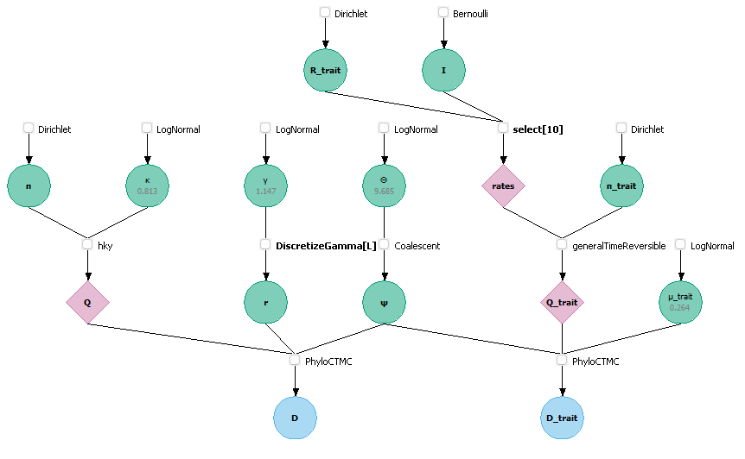
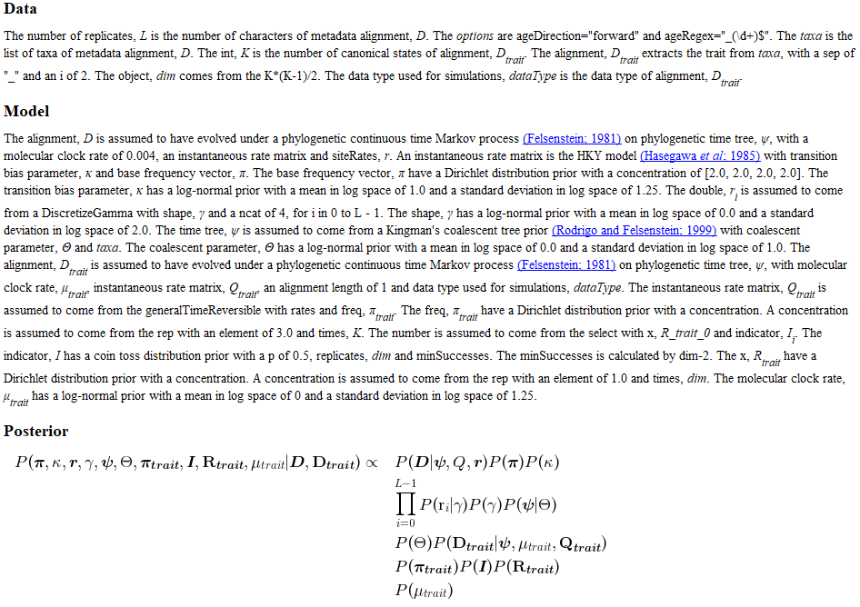
DAG and Model Description

Slide 33
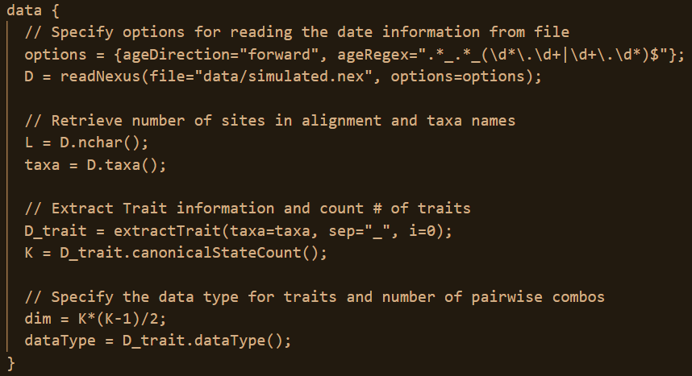
Data Block

Slide 34
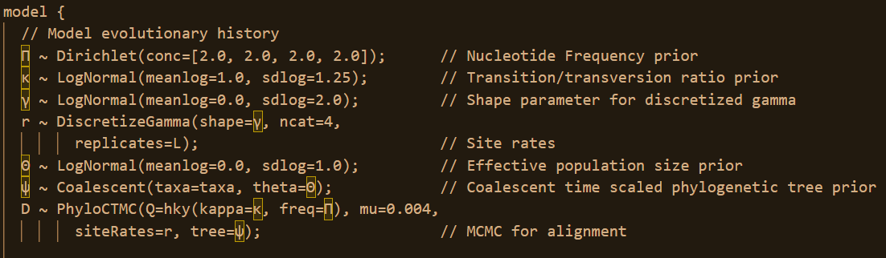
Model Block (Sequence Evolution)

Slide 35
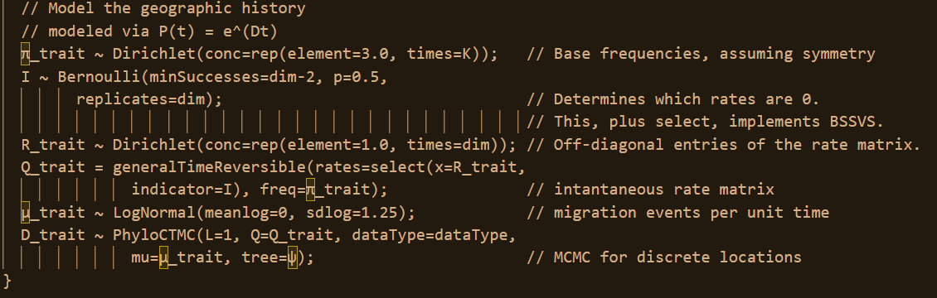
Model Block (Discrete Geography)

